Slide 2
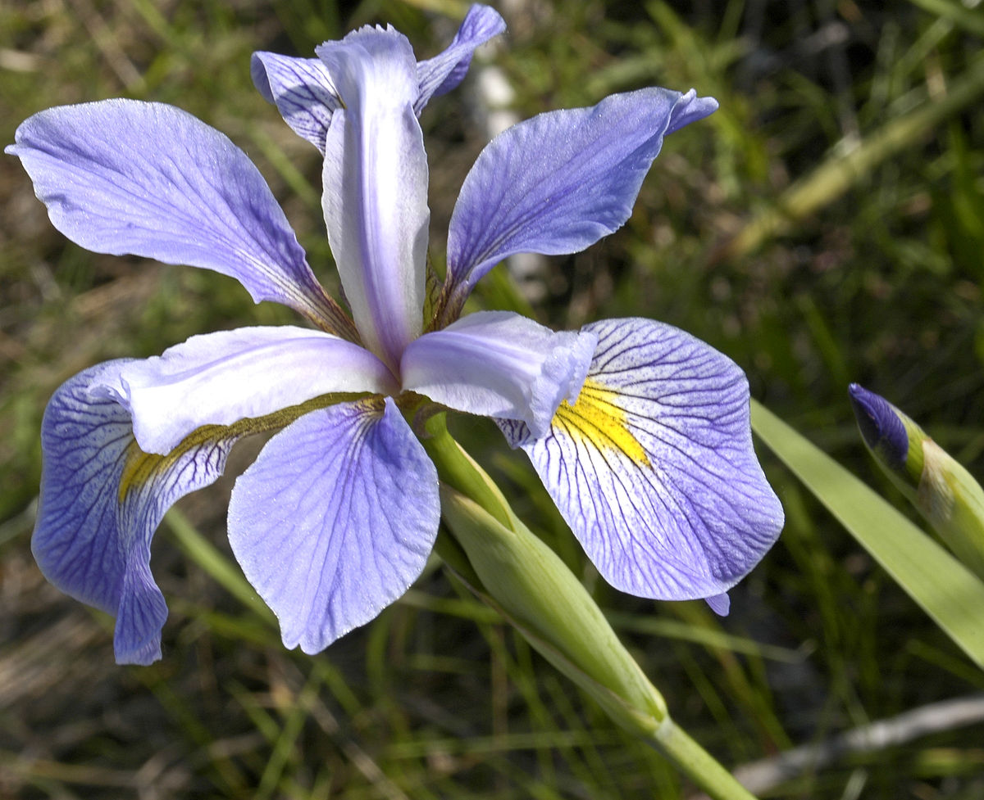
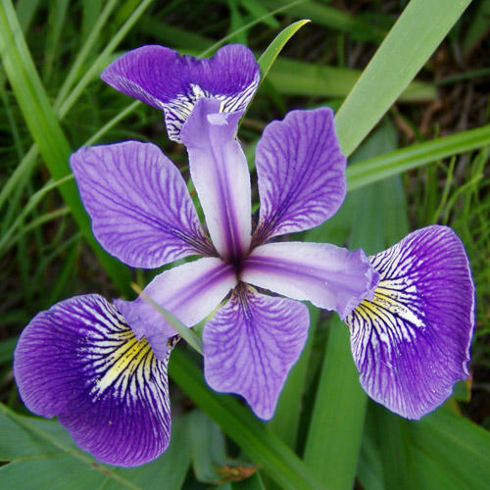
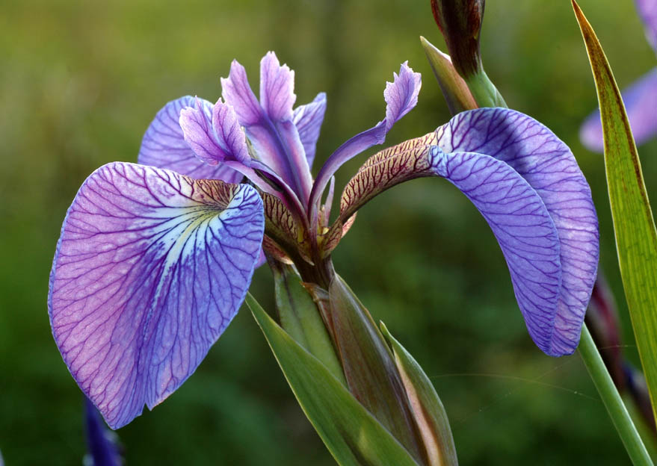
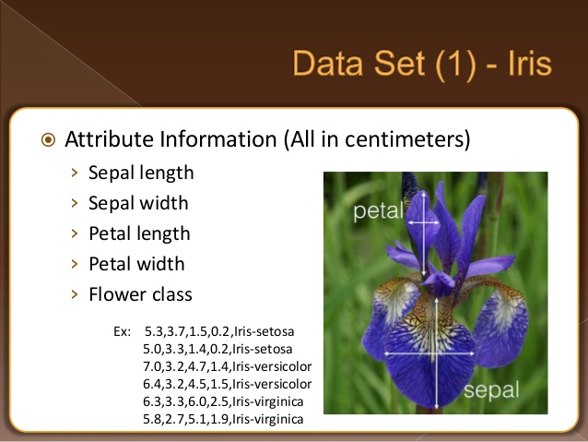
IRIS VIRGINICA
IRIS VERSICOLOR
IRIS SETOSA

Slide 3
TRAINING PHASE: The Neural Network will learn from 100 samples like this:
Sepal Length | Sepal Width | Petal Length | Petal Width | Iris Species
6.8 | 2.8 | 4.8 | 1.4 | versicolor
4.8 | 3.0 | 1.4 | 0.3 | setosa
6.1 | 2.9 | 4.7 | 1.4 | versicolor
5.8 | 2.7 | 5.1 | 1.9 | virginica
TESTING PHASE: The Neural Network will be tested with 50 samples like this.
Sepal Length | Sepal Width | Petal Length | Petal Width | Iris Species
5.0 | 3.4 | 1.5 | 0.2 | ?
5.6 | 3.0 | 4.5 | 1.5 | ?
5.9 | 3.2 | 4.8 | 1.8 | ?
6.7 | 3.3 | 5.7 | 2.1 | ?
As we know the correct Iris Species for each sample, we will compare the Neural Network output with the correct answer.

Slide 4
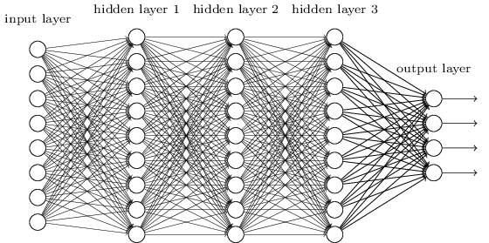
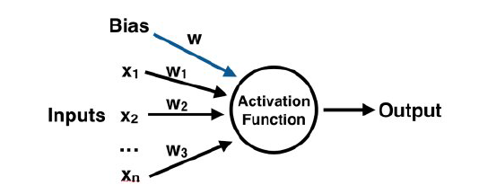
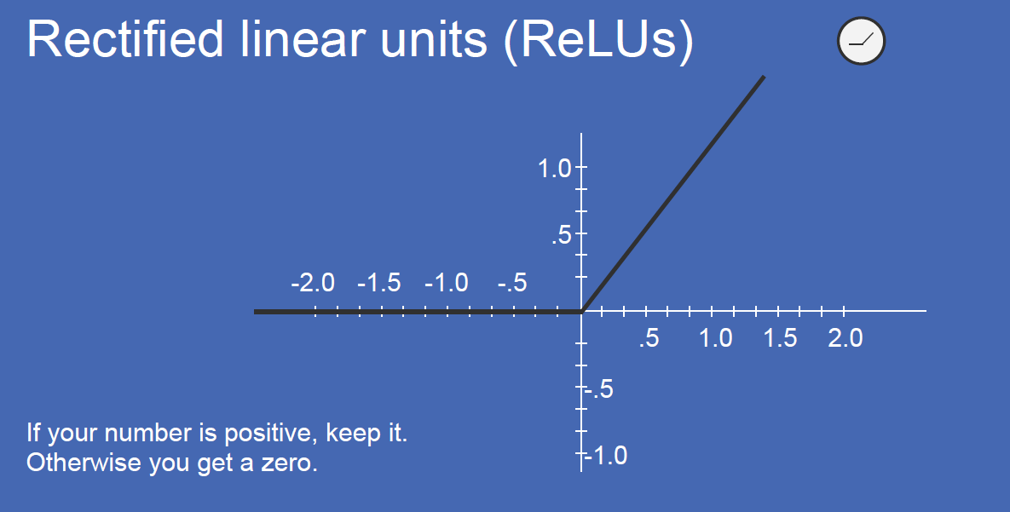
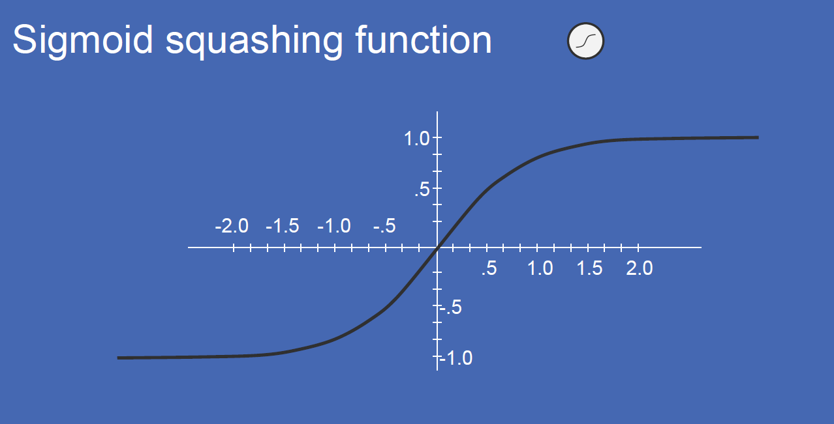
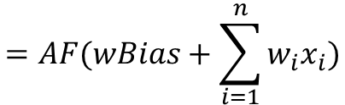
Example of Neural Network
Structure and Operation of the single Neural Node
AF()
$$=AF(wBias+\sum_{i=1}^{n}{w_{i}x_{i}})$$
Each Neural Node calculates a linear weigthed combination of the inputs plus an arbitrary number called bias. This sum is processed by a nonlinear function called Activation Function, see below two exampled of Activation Function.
Example of a Neural Network with three Hidden Layers
Examples of Activation Functions AF()

